Slide 1
Understanding the Java Virtual Machine
Memory Management
INTRODUCTION

Slide 2
Why GC?
create and forget: no need to remember
to delete
Account acc = new Account();
use and forget: no need to ask “Should I delete?”
Account acc = getAccount();
use with confidence: objects will not
vanish or become corrupt
behind your back
acc.increment(amount);

Slide 3
The GC Promise
Claim no live objects
- no promises about dead objects
Account acc = new Account(); acc = new Account();
first account dead (no longer referenced):
may be reclaimed
acc
second account live (still referenced by acc):
will not be reclaimed

Slide 4
Java 8 Still Widely used
Course runs on Java 11
Things changed in Java 7
G1 garbage collector introduced
Things changed in Java 9
CMS garbage collector deprecated
Finalizers deprecated
Cleaner introduced
A Note on Versions

Slide 5
Forms of Garbage Collection
Do Nothing
Reference Counting
Mark and Sweep
Copying
Generational
Incremental

Slide 6
Reference Counting
2
1
1
Onus on client to call methods when allocating/freeing memory
COM for example had AddRef and Release calls for objects
When count hits zero object can be freed
Problems with circular references

Slide 7
Reference Counting
Account acc = new Account(); acc = new Account();
1 assignment,
1 deassignment, ref count = 0
acc
0
1

Slide 8
‘mark’ phase that identifies the objects that are still in use
‘sweep’ phase to remove unused objects ‘compact’ phase to compact the memory
Mark and Sweep

Slide 9
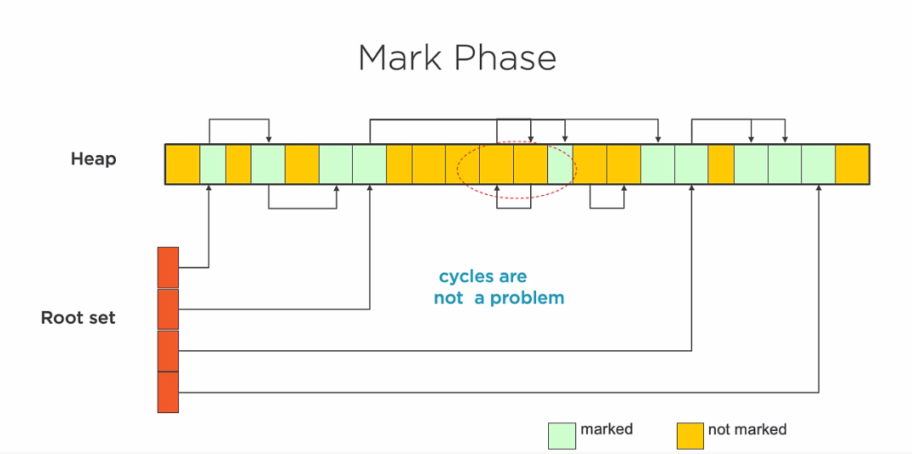

Slide 10
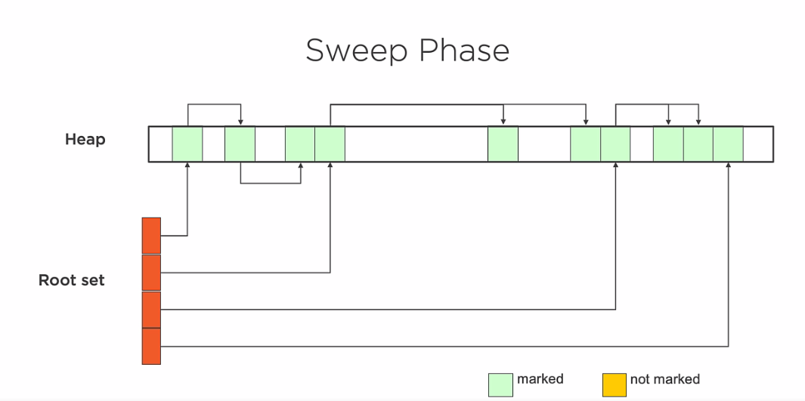

Slide 11
Compact Phase
Heap
cycles are
not a problem
Root set
marked
not marked

Slide 12
Copying
Uses different ‘spaces’ to manage memory

Slide 13
Copying Fromspace to Tospace
fromspace
1
2
3
4
tospace
Root set
live
dead
free

Slide 14
Copying Fromspace to Tospace
fromspace
2
3
4
1
tospace
Root set
live
dead
free

Slide 15
Copying Fromspace to Tospace
fromspace
3
4
1
2
tospace
Root set
live
dead
free

Slide 16
Copying Fromspace to Tospace
fromspace
4
1
2
3
tospace
Root set
live
dead
free

Slide 17
Copying Fromspace to Tospace
fromspace
1
2
3
4
tospace
Root set
live
dead
free

Slide 18
Copying Fromspace to Tospace
fromspace
1
2
3
4
tospace
Root set
live
dead
free

Slide 19
Maintain different generations for memory
Generational Collectors
Long living objects ‘promoted’ to a different generation
For a given definition of ‘long’

Slide 20
Before a Generational Minor Collect
Young Generation
Old Generation
1
2
3
4
Root set
live
dead
free
unknown

Slide 21
After a Generational Minor Collect
Young Generation
Old Generation
 | 4 | 3 | 2 | 1
Root set
live
dead
free
unknown

Slide 22
Demo
Showing GC in action

